Slide 1


Cartoon Character Classifier
Colin, Le Fan, Yuandi, Andre, Rongjia

Slide 2

Table of Contents
Project Overview
Data Processing
Model Selection
Model Summary
Model Results

Slide 3
Rubric
1. Quality of Presentation
Clean and Engaging Slides
Displayed Mastery of Subject
Ability to Answer Q&A
Under 6 Minutes
2. Quality of Visualizations
Aesthetic Design Choices
Appropriate Axes and Labels
Well-Chosen Visualizations
Visualizations Get Across Project Objectives
3. Effective Use Of Analysis / Machine Learning
Effective Data Cleaning
Justified Model Selection
Attempts at Performance Improvements
Clear Training and/or Statistical Analysis
4. Creativity + Displayed Effort
Interesting Project Selection
Quality of Code
Proportional Challenge Taken On
Creative Problem Solving

Slide 4
Overview
Objective: Identify and differentiate between characters in a cartoon
Project: Image classification tool using machine learning and computer vision techniques on characters from the cartoon series “Tom and Jerry”.
Chosen models:
Convolutional neural networks (CNN): specifically designed and highly effective in image recognition tasks
Fully convolutional neural networks (FCNN): designed for image segmentation/more precision (per-pixel classification)
k-NN and Random Forest models using the extracted features from CNN/FCNN
After this, we will try and improve on these models based on their performance.
The model’s performance will be evaluated based on its accuracy, precision, and ability to generalize across unseen test images.

Slide 5
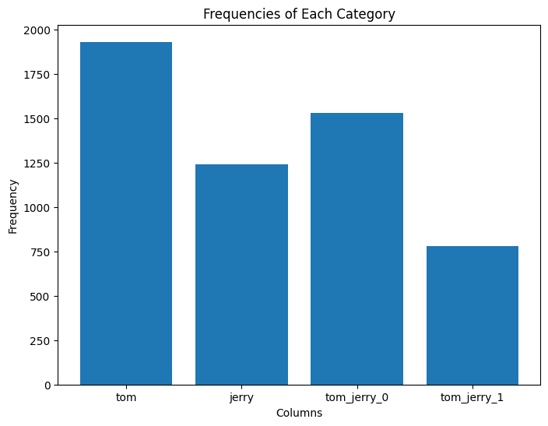
Data Processing
Data exploration
Dataset from Kaggle included four image folders with a csv file using binary classification to tell if tom or jerry was in each frame
Data transformation
Creating tom_jerry_0 and tom_jerry_1, where neither Tom and Jerry are in frame and where both Tom and Jerry was in frame
Initial Data Visualization
Frequencies of Each Category out of 5478

Slide 6
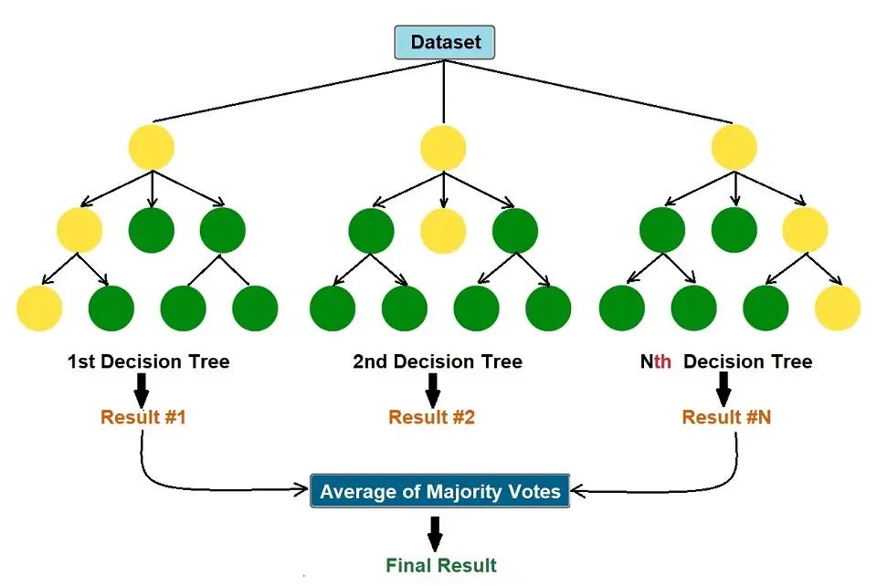
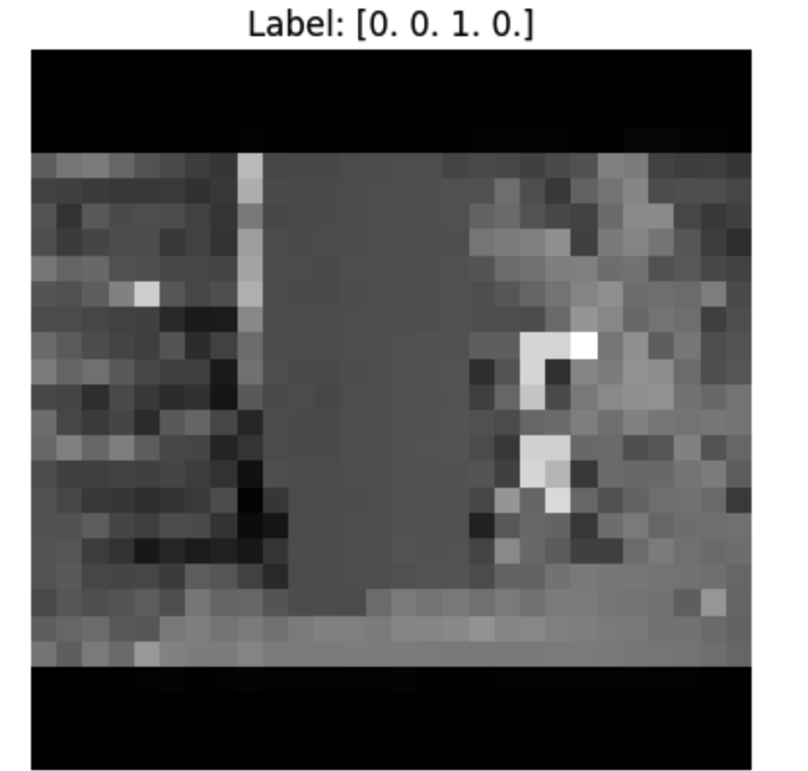
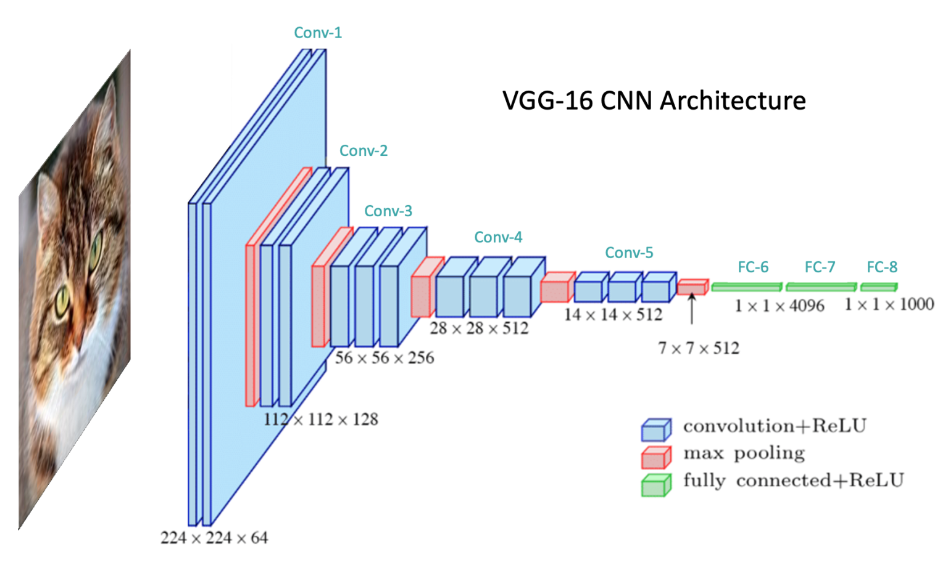
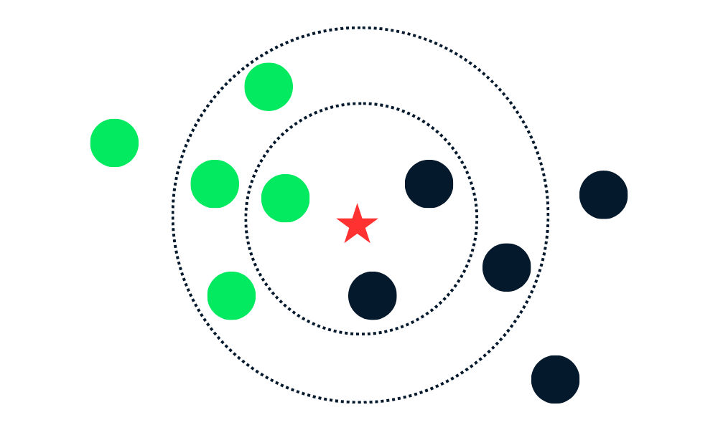
Model Selection
CNN model
FCNN model
Random Forests using CNN features
kNN using CNN features
CNN with RELU (Rectified Linear Unit)
CNN with 2D Maxpooling
Random Forest without CNN
kNN Without CNN

Slide 7
Model Summary:
Why do certain models perform better?
Model Architecture:
CNNs are suited for image data, they can extract spatial features from images.
Decision tree models like Random Forests are effective at handling high-dimensional data and are resistant to overfitting.
Combining these two types of models allows us to leverage the strengths of each.
Feature Extraction:
CNN models can extract high-level features from raw images, often capturing essential elements such as edges and shapes.
Random Forests can then classify based on these features. As a result, using CNN feature outputs as inputs to a Random Forest model often leads to better results.

Slide 8
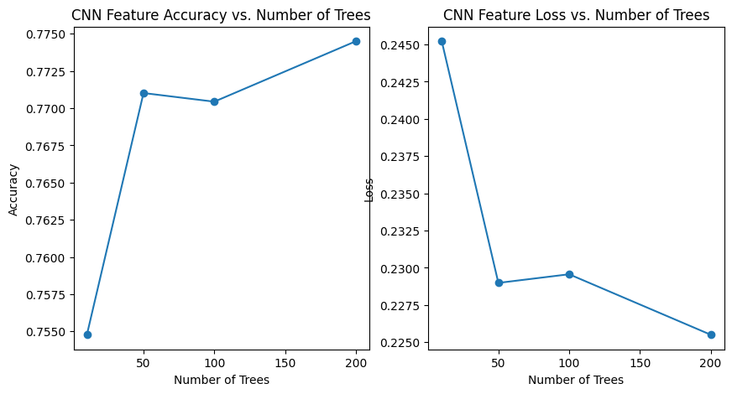
Model Summary:
Advantages of Ensemble Methods:
Random Forests reduce overfitting and improve the stability and accuracy of predictions by combining multiple decision trees.
This ensemble learning approach allows the model to handle complex data more effectively.

Slide 9
Model Summary:
Reasons for Choosing a Specific Model:
Accuracy Improvement -
Our experimental results show that while CNN alone achieves a reasonable accuracy, extracting CNN features and classifying with Random Forest significantly improves accuracy.
For example, using Random Forest after extracting features from CNN increased accuracy to around 79.57%.
Interpretability -
Combining CNN and Random Forest provides not only higher classification accuracy but also a clearer understanding of the model’s decision-making process.
Each tree in a Random Forest can be seen as a decision on a specific combination of features, making the analysis more accessible.

Slide 10
Model Summary:
Reasons for Choosing a Specific Model:
Feature Examples:
We extract features from the penultimate layer of a pre-trained CNN model.
These features often highlight distinct shape and edge characteristics, showing many lines, circles, and edges that represent the high-level abstract features necessary for image classification.

Slide 11
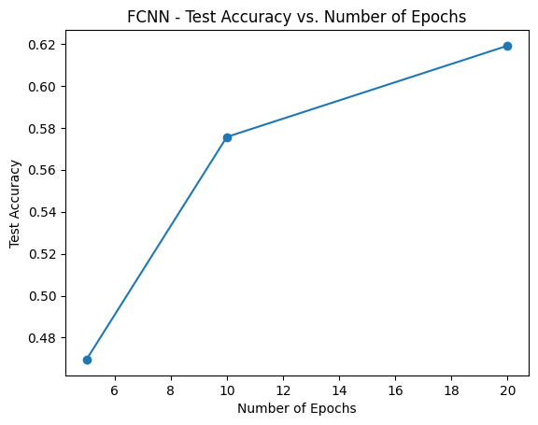
Model Results
Initial CNN model: 73.62% - extract features
Initial FCNN model: 61.91% with 20 epochs
Random Forests using CNN features: 78% with 150 trees
kNN using CNN features: 78.08%
CNN with RELU (Rectified Linear Unit) accuracy: 64.22%
CNN with 2D Maxpooling accuracy: 42.00%
Random Forest without CNN: 81.13%
kNN Without CNN: 76%

Slide 12
Question: Why CNN is not always the best
Data Requirements: CNNs need large datasets to learn effectively, while k-NN and Random Forests often perform better on smaller datasets, especially for structured or tabular data.
Computational Cost: CNNs are computationally heavy, requiring more processing power and slower to train and run, whereas k-NN and Random Forests are faster and more efficient.
⭐️Overfitting Risk: CNNs can overfit small or imbalanced datasets, while Random Forests, with their ensemble approach, are more robust in these scenarios.
Interpretability: CNNs are complex and harder to interpret. In contrast, Random Forests (via decision trees) and k-NN offer more transparency in decision-making.

Slide 13



